Slide 1


Slide 2
eekScape

Slide 3






eekScape
Our Targets
18-30 years old
Budget-Conscious Travelers
Solo Travelers
Social Explorers
Personal Growth-Oriented Adventurers

Slide 4
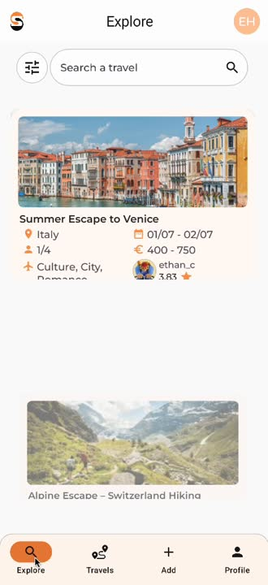
eekScape
See upcoming trips
in
Explore

Slide 5
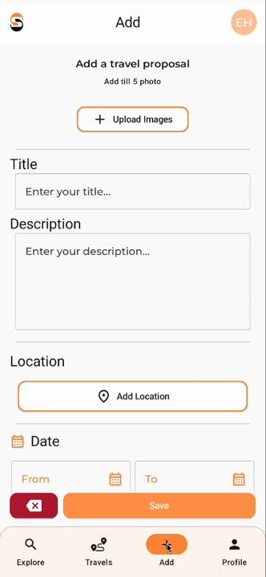
eekScape
Create a new experience

Slide 6
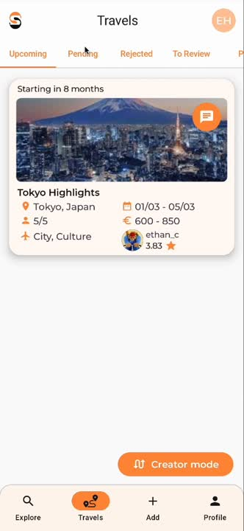
eekScape
Manage your trips in Travels

Slide 7
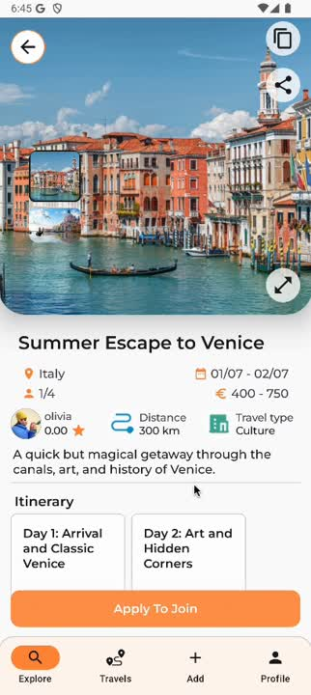
eekScape
Apply for new adventures

Slide 8
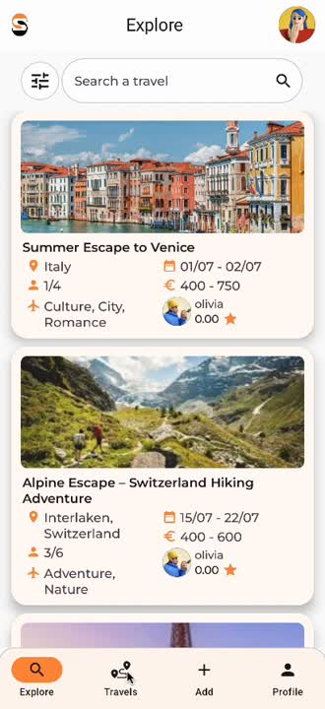
eekScape
Rate your past experiences and companions

Slide 9
Our new features

Slide 10
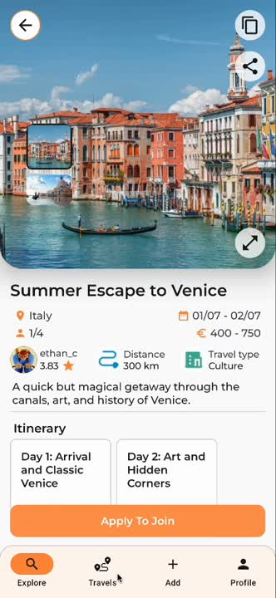
eekScape
Get in touch with your travel companions

Slide 11
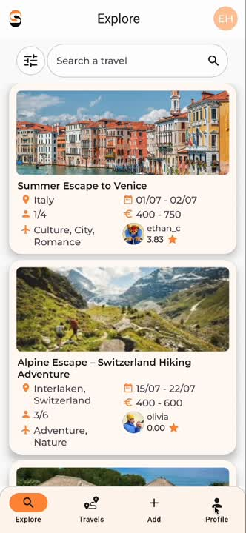
eekScape
Use our dark mode

Slide 12
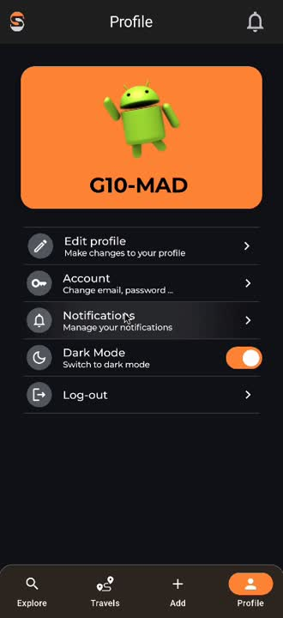
eekScape
Manage your notifications

Slide 13
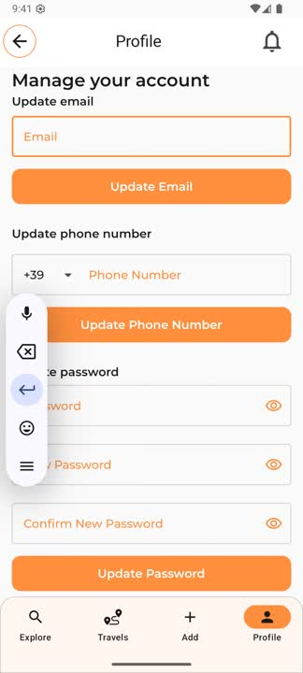
eekScape
Modify your login information

